Slide 1
Investigating the relationship between Open Access, citations and altmetrics
Nicholas Fraser
CWTS, Leiden, Netherlands
7th February 2019

Slide 2
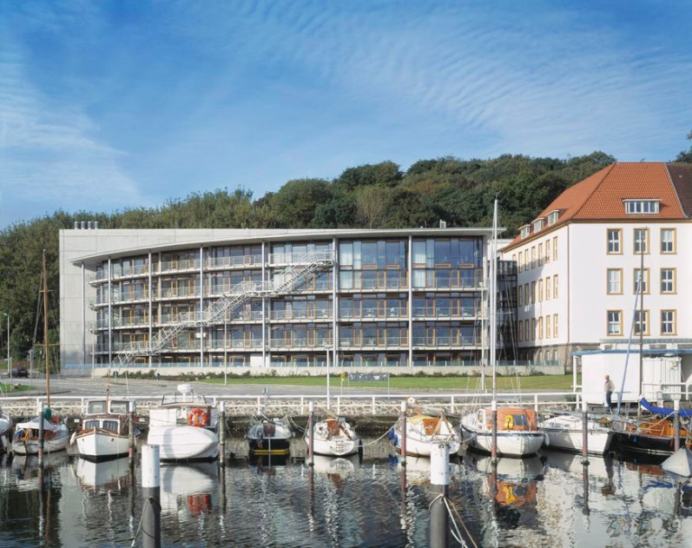
Who am I?
Academic background in Earth Science (PhD in paleoclimatology)
Then worked for 2.5 years at an academic publisher (Frontiers)
Now a postdoctoral researcher at ZBW Kiel, Germany

Slide 3

“Open AccesS Effects”
Joint project between GESIS (Philipp Mayr, Masoud Davari, Fakhri Momeni) and ZBW (Isabella Peters, Nicholas Fraser).
Broad aim is to investigate factors influencing the impact of OA publications:
Structural factors (OA mandates, publishing models)
Authorship factors (demographics, selectivity)

Slide 4
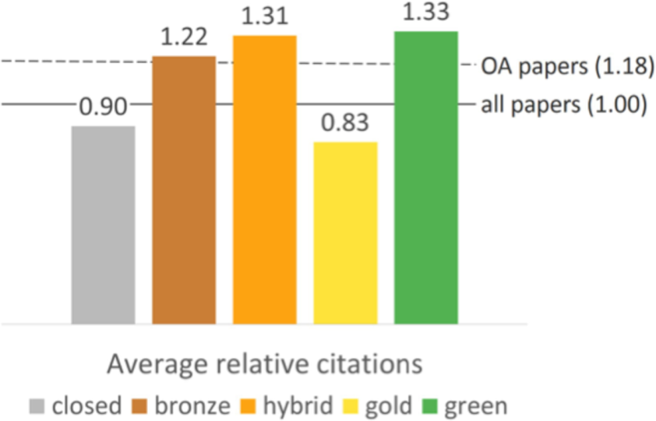
The OA citation advantage
Plan S: “There is no valid reason to maintain any kind of subscription-based business model for scientific publishing in the digital world, where Open Access dissemination is maximising the impact, visibility, and efficiency of the whole research process¹ ”.
OA articles are generally cited more than non-OA articles (“OA citation advantage”).
Citation rates differ by the route to OA: articles published via the Gold route tend to receive less citations than via Green/Hybrid routes.
Piwowar et al. (2018): https://doi.org/10.7717/peerj.4375
¹ https://coalition-s.org/why-plan-s/
Notes:
Why does it matter?
Uncertainty for authors: why should I publish my article in an OA journal/institutional repository?
Policy makers

Slide 5
The OA citation advantage
Why are OA publications cited more than non-OA publication?
Open Access effect
A paper is open, therefore it is easier to download, read, and to cite
The rich get richer
Early Access effect
Earlier availability (via self-archiving) leads to a (short-term) boost in citation rates
Quality effect
Higher quality papers are overrepresented amongst OA papers
Authors self-select their highest quality papers to make OA

Slide 6
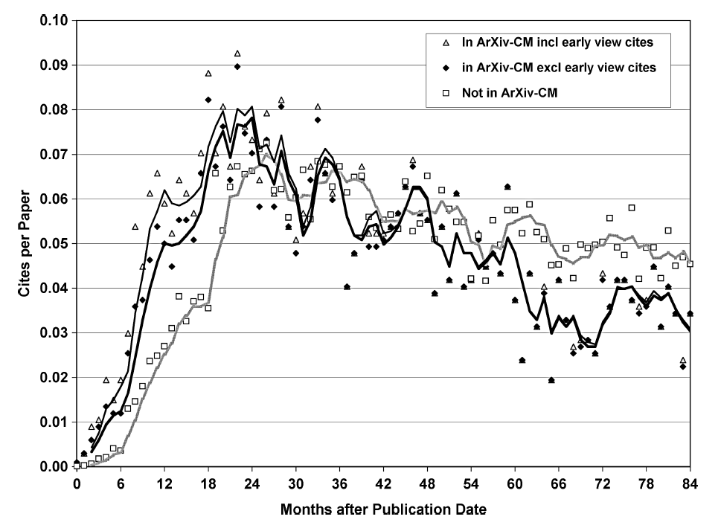
The Early Access effect
Journal articles that were previously deposited to arXiv were cited more quickly following journal publication than articles not deposited (e.g. Davis and Fromerth, 2007, Moed, 2007; Gentil-Beccot et al., 2010; Larivière et al., 2014).
Moed (2007): https://arxiv.org/abs/cs/0611060
Notes:
arXiv-CM = Condensed Matter

Slide 7

Rise of the preprints
https://osf.io/preprints/

Slide 8
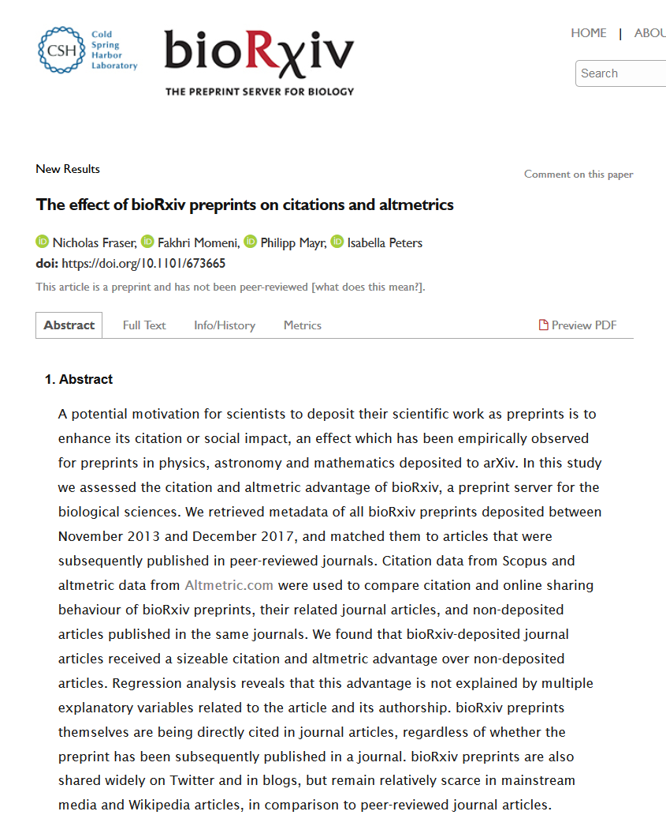
The Early Access effect in bioRxiv
Do the findings from arXiv apply to other subject areas?
Can we say something about the mechanism driving differences in citation behaviour between articles with and without preprints?
What about other metrics of impact, e.g. altmetrics?
https://doi.org/10.1101/673665

Slide 9
Data retrieval
Retrieve preprint metadata (N ~18,000)
(Crossref)
Match preprints to journal articles (N ~ 7000)
(Crossref, bioRxiv website*, Scopus)
Month and journal-matched control group
(N ~ 7000) (Scopus)
Citation counts, monthly aggregated (Scopus, Crossref)
Altmetric counts (Altmetric.com)
*See R package: https://github.com/nicholasmfraser/biorrxiv
Notes:
Study period limited from 2013 to 2017

Slide 10
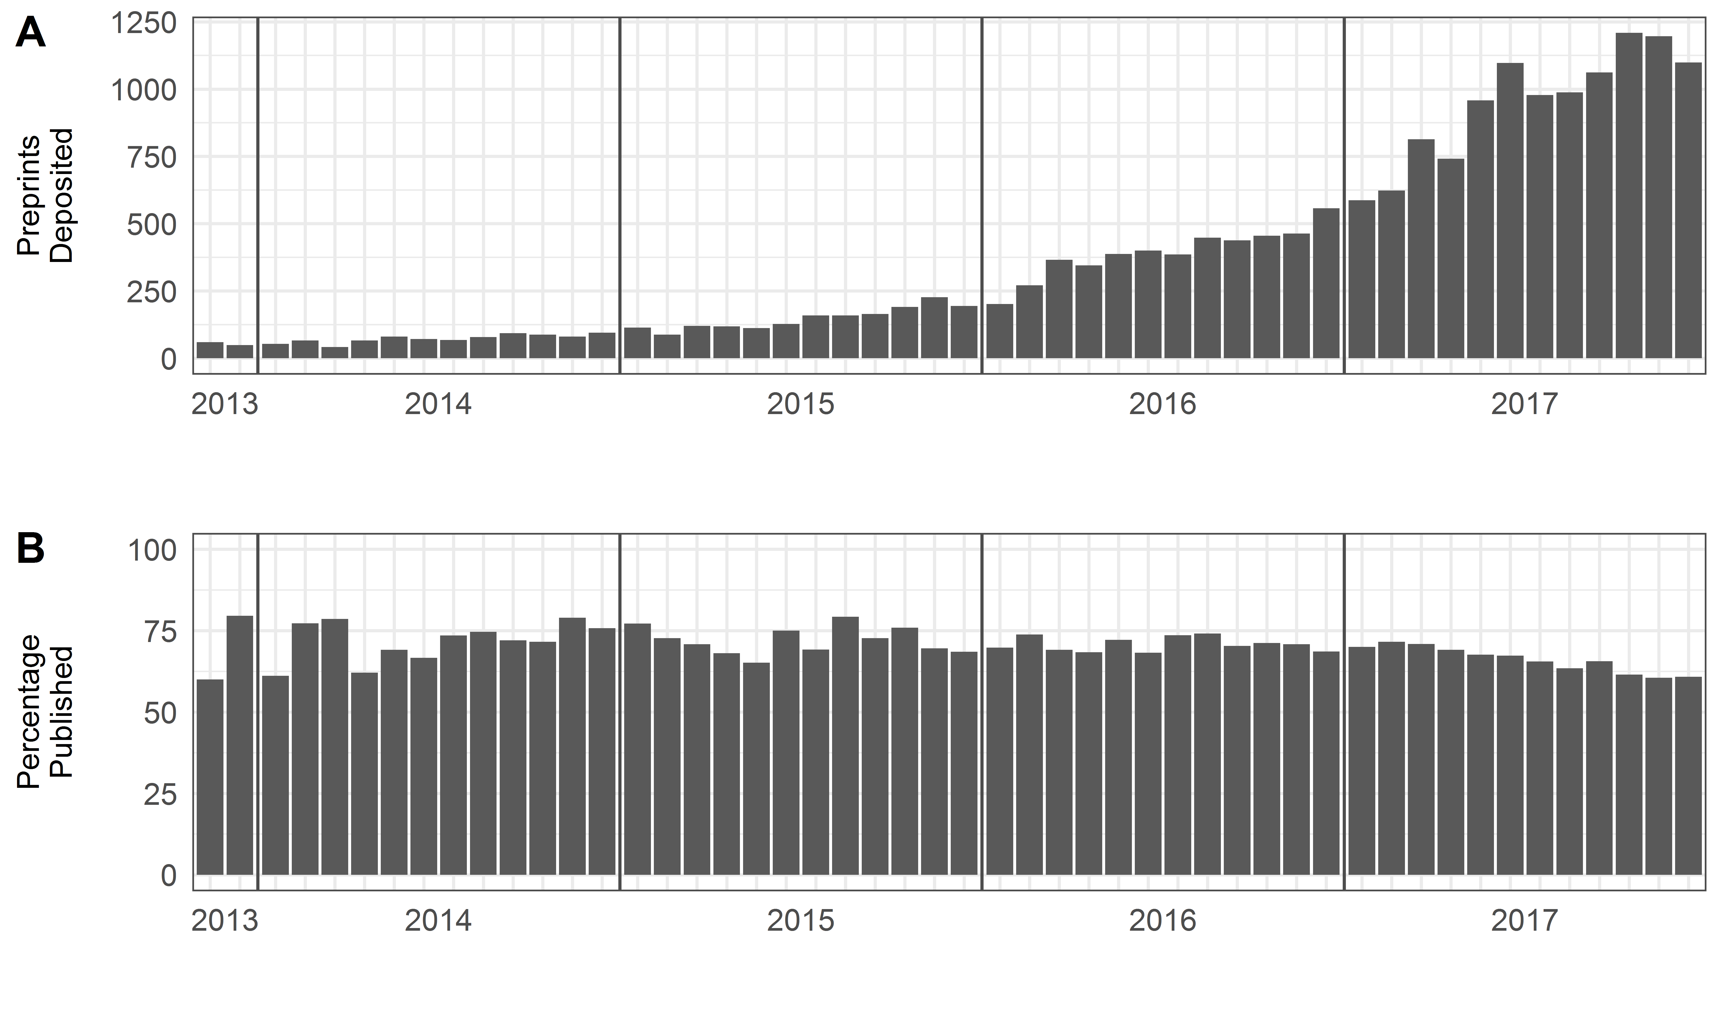
Development of bioRxiv

Slide 11
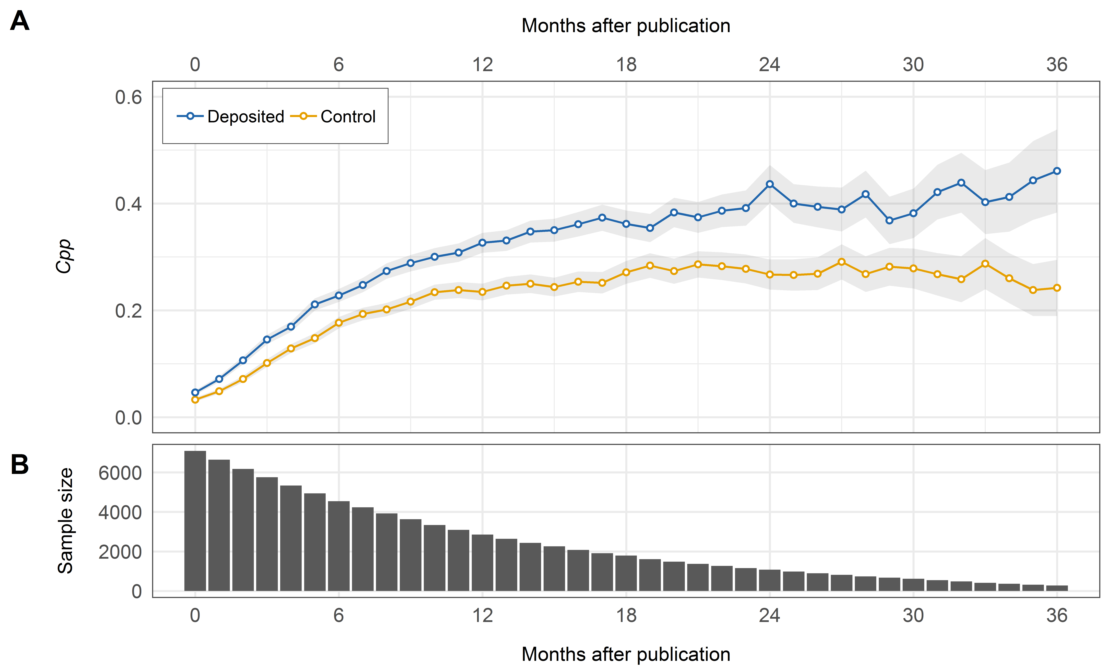
Is there an Early Access effect in bioRxiv?
Cpp = ∑(log(Citations+1) / N

Slide 12
What about altmetrics?

Slide 13
Are citations/altmetrics driven by author/article characteristics?
Characteristic | Variable | bioRxiv-deposited | Control
Journal Impact Factor | Median Journal Impact Factor | 4.53 | 4.53
OA article | % papers that are OA | 88.1 | 83.5
Review article | % review articles | 2.79 | 5.32
Author count | Median author count per article | 5 | 6
First author from USA | % US first authors | 49.3 | 37.4
Last author from USA | % US last authors | 49.5 | 37.6
First author academic age | Median first author academic age (years) | 5 | 5
Last author academic age | Median last author academic age (years) | 17 | 19
First author gender | % articles with female first authors | 29.9 | 36.0
Last author gender | % articles with female last authors | 18.0 | 23.9
Regression analysis shows that when controlling for these characteristics, preprint deposition remains a strong predictor of future citations.

Slide 14
Summary
Journal articles deposited as preprints on bioRxiv received more citations and higher counts in multiple altmetric indicators than articles not deposited.
The citation advantage is long-lasting (at least 36 months), in conflict with some findings from arXiv suggesting that the “Early Access effect” is only a short-term effect.
The citation and altmetric advantage is not well explained by a range of factors relating to the article and its authorship.
Follow-up study in progress: survey of bioRxiv authors to investigate preprint depositing strategies (e.g. do authors deposit all of their work to bioRxiv, or just their best/most citable work….?)

Slide 15
Open Access and Altmetrics
ElSabry (2017): “There is strong support of the idea that Open Access has benefits to different groups of people outside the university/credentialed research institutes. It is not clear how much evidence is available to support these claims, but identifying them would suggest new stakeholders to involve in the conversation and perhaps also inform the ongoing debate about who should bear the cost of Open Access¹.”
Can altmetrics provide some empirical evidence to support these claims?
¹ https://doi.org/10.3233/978-1-61499-769-6-34

Slide 16
Previous Work
Robinson-Garcia et al. (2018): “…gold OA documents are best covered in Altmetric.com and receive higher mentions than documents with other types of access””in two Physics journals.
Holmberg et al. (2019): “The results show significant disciplinary and platform specific differences in the OA advantage” in a study of articles published by Finnish Universities.
Alhoori et al. (2015): “…we found that OA articles receive higher altmetrics than [closed] articles; however, we found less significant differences when taking into consideration some influential factors such as journal, publication year, and citation count” based on comparisons of OA and closed articles in Hybrid journals.
Teplitskiy et al. (2016): “Controlling for field and impact factor, the odds that an open access journal is referenced on the English Wikipedia are 47% higher compared to paywall journals.”

Slide 17
Research Questions
RQ1: Do OA articles receive more/different altmetric attention than non-OA articles at the global level?
RQ2: Do articles with different types of OA differ in the altmetric attention they receive?
RQ3: Which additional factors influence the relationship between OA and altmetrics*?
RQ4: What are the limitations with current data sources in measuring the large-scale relationship between OA and altmetrics?
* e.g. time, document types, disciplines, authorship countries, journal prestige…

Slide 18
Data retrieval
Article corpus: Web of Science, 2012-2018, Article and Review type documents (CWTS database)
OA classification
OA classification
Altmetrics information (Altmetric.com)

Slide 19
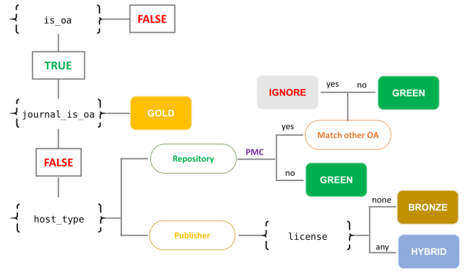
Open Access Classification
Classifications at two levels, based on Unpaywall metadata schema:
OA versus non-OA
By OA types:
Gold
Hybrid
Bronze
Green

Slide 20
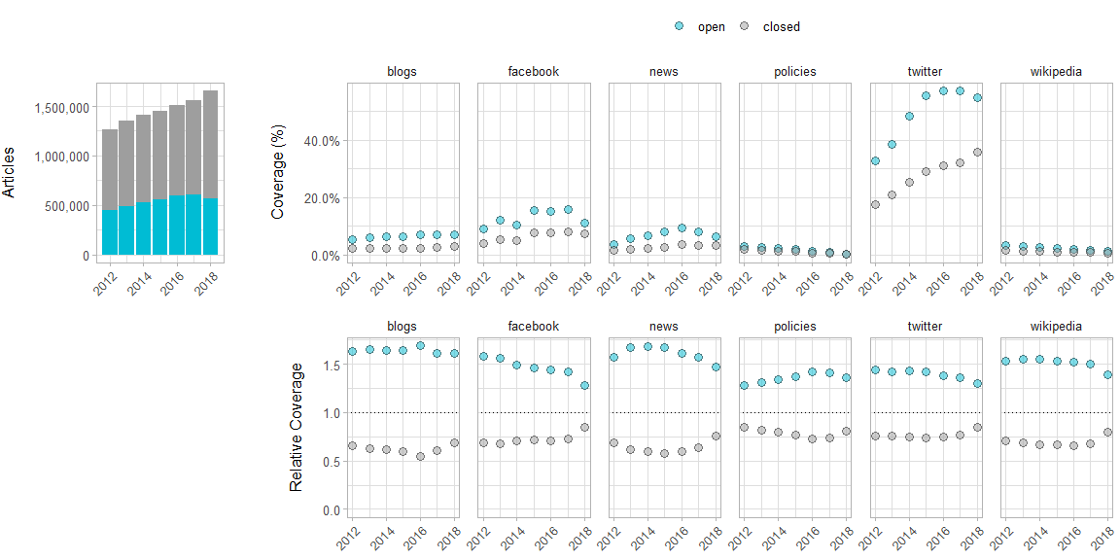

RQ1: Do OA articles receive more/different altmetric attention than non-OA articles?
$$\frac{{Coverage}_{subset}}{{Coverage}_{all}}$$

Slide 21
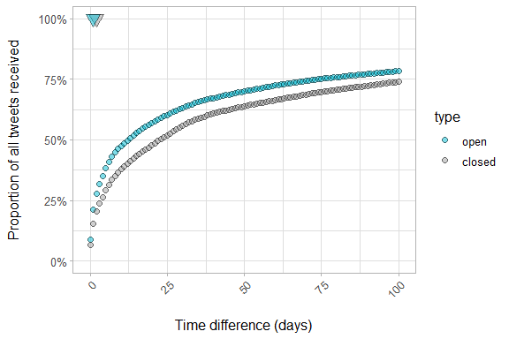
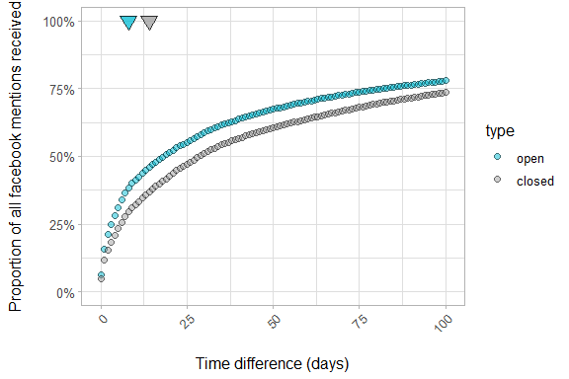
RQ1: Do OA articles receive more/different altmetric attention than non-OA articles?
Twitter
Facebook

Slide 22
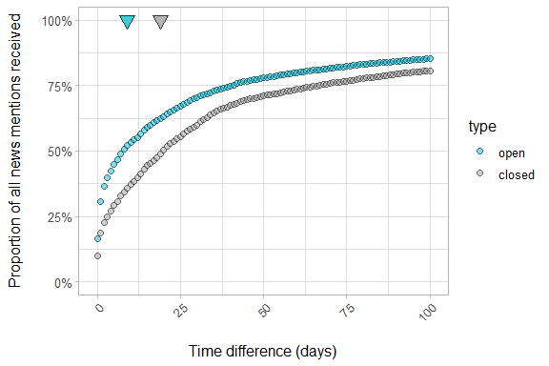
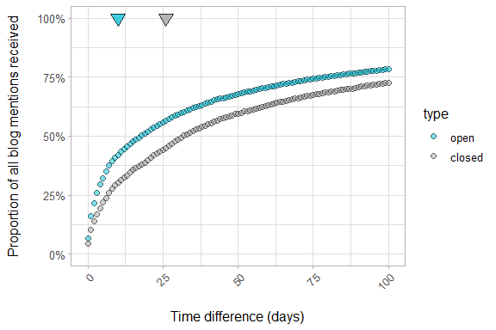
RQ1: Do OA articles receive more/different altmetric attention than non-OA articles?
News
Blogs

Slide 23
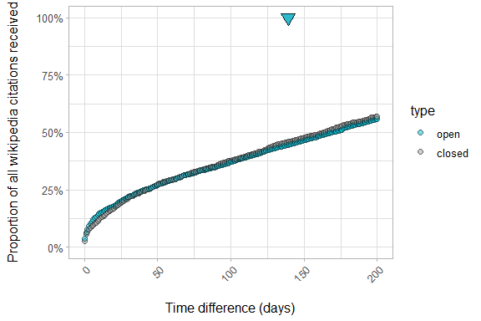
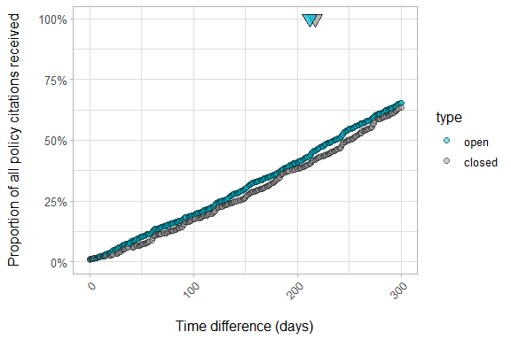
RQ1: Do OA articles receive more/different altmetric attention than non-OA articles?
Wikipedia
Policies

Slide 24
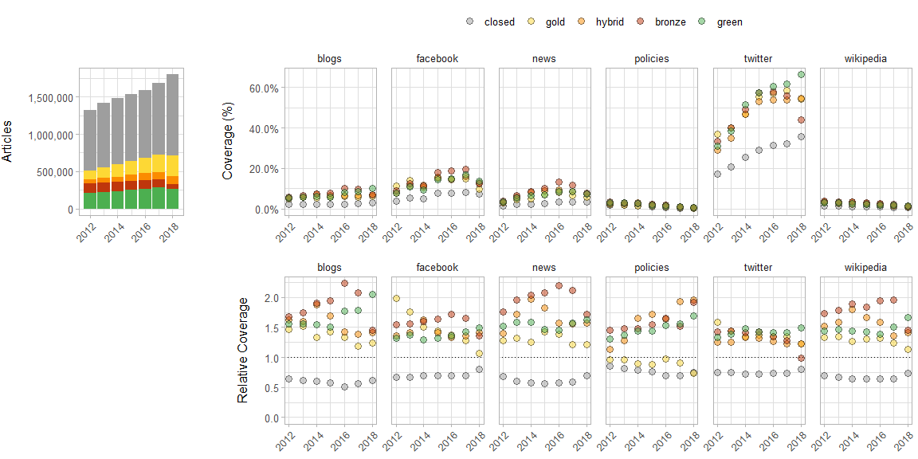
RQ2: Do articles with different types of OA differ in the altmetric attention they receive?

Slide 25
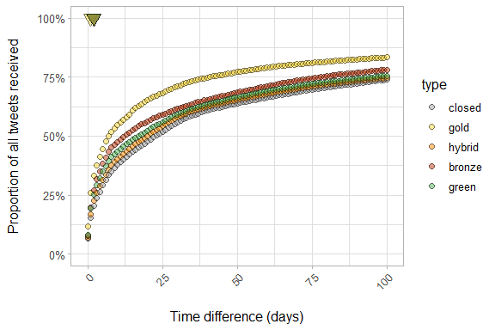
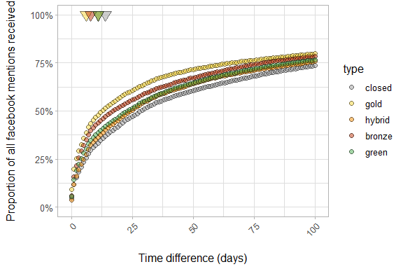
RQ2: Do articles with different types of OA differ in the altmetric attention they receive?
Twitter
Facebook

Slide 26
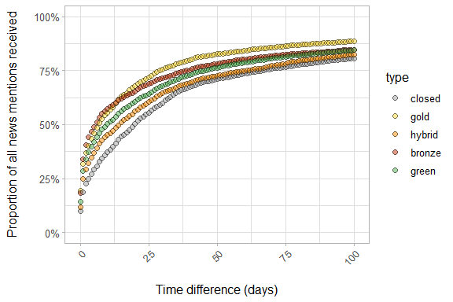
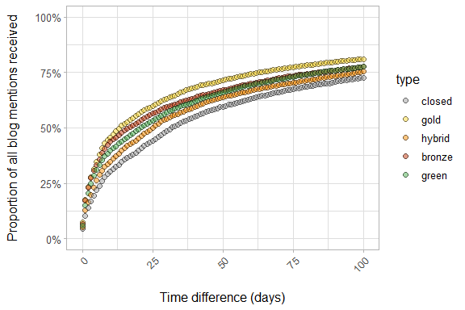
RQ2: Do articles with different types of OA differ in the altmetric attention they receive?
News
Blogs
Notes:
Add arrows for first mentions

Slide 27
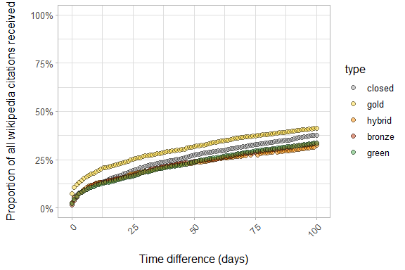
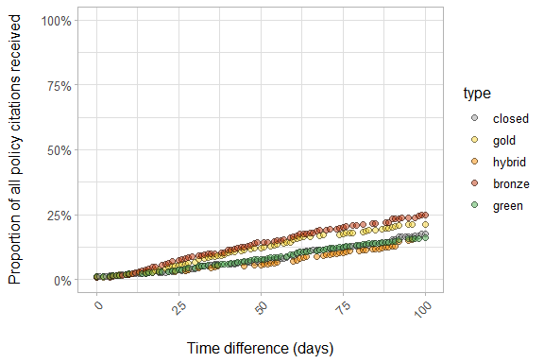
RQ2: Do articles with different types of OA differ in the altmetric attention they receive?
Wikipedia
Policies
Notes:
Add arrows for first mentions

Slide 28
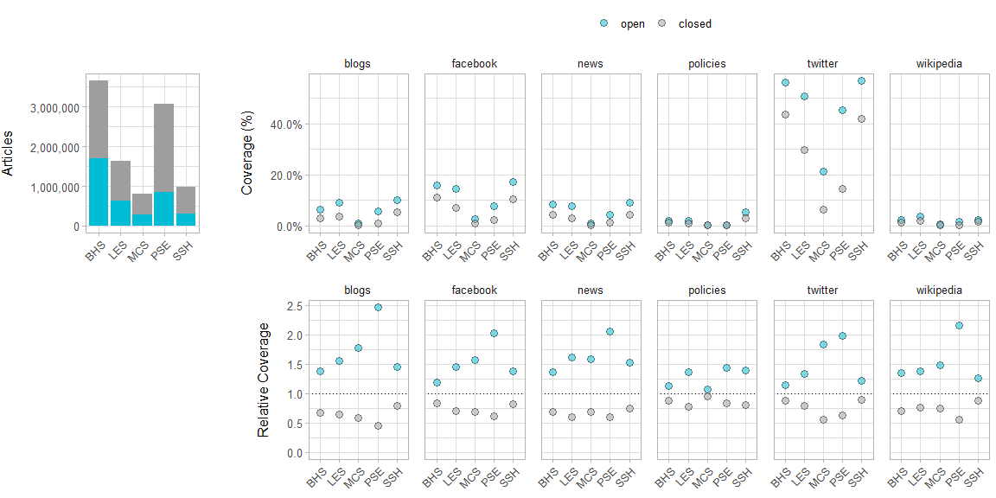
RQ3: Which additional factors influence the relationship between OA and altmetrics? -> Disciplines
Biomedical and Health Sciences
Life and Earth Sciences
Mathematical and Computer Sciences
Physical Sciences and Engineering
Social Sciences and Humanities

Slide 29
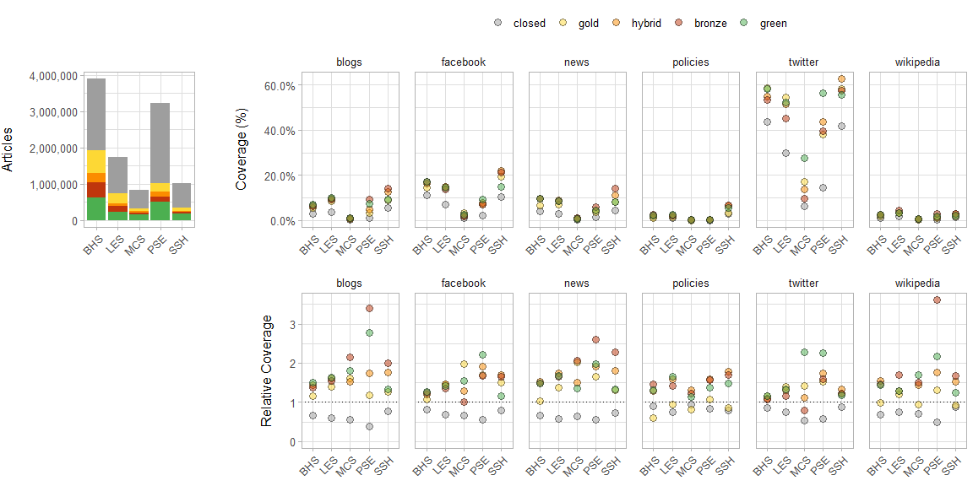
RQ3: Which additional factors influence the relationship between OA and altmetrics? -> Disciplines
Biomedical and Health Sciences
Life and Earth Sciences
Mathematical and Computer Sciences
Physical Sciences and Engineering
Social Sciences and Humanities

Slide 30
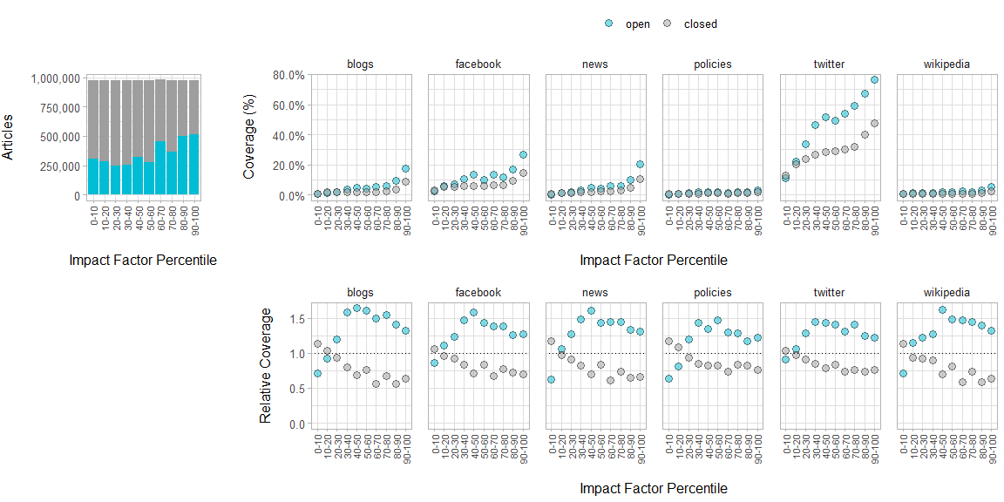
RQ3: Which additional factors influence the relationship between OA and altmetrics? -> Journals

Slide 31
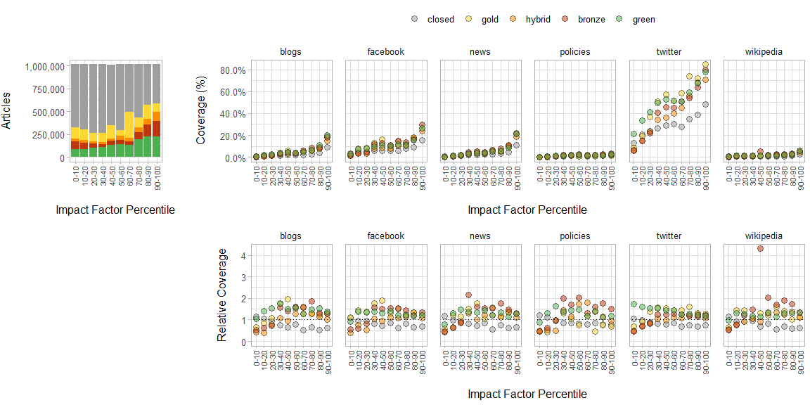
RQ3: Which additional factors influence the relationship between OA and altmetrics? -> Journals

Slide 32
RQ3: Which additional factors influence the relationship between OA and altmetrics? -> Countries?

Slide 33
RQ4: What are the limitations in measuring the large-scale relationship between OA and altmetrics?
Units of analysis (discipline/countries/document types) cannot be considered in isolation – interaction between different factors must be considered.
Data presented here are purely observational – no proof of causality (!).
Significant barriers with respect to coverage and content of data sources themselves, which may introduce systematic bias into analyses.

Slide 34
Summary
Combining data from the Web of Science, Unpaywall and Altmetric.com, we observe that OA articles are shared, mentioned and cited more than closed articles in multiple altmetric sources (blogs, Facebook, news, policies, Twitter, Wikipedia). In addition, OA articles are shared more rapidly on plat
Limitations

Slide 35
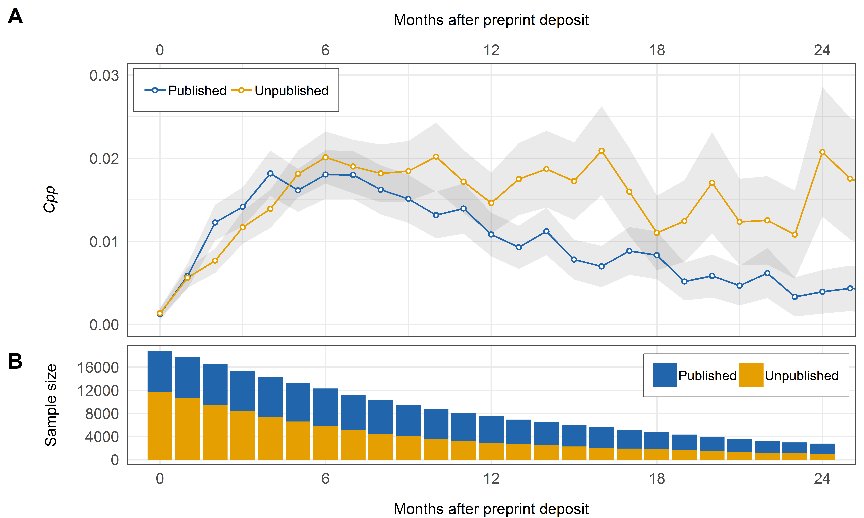
Direct citations to published and unpublished preprints

Slide 36
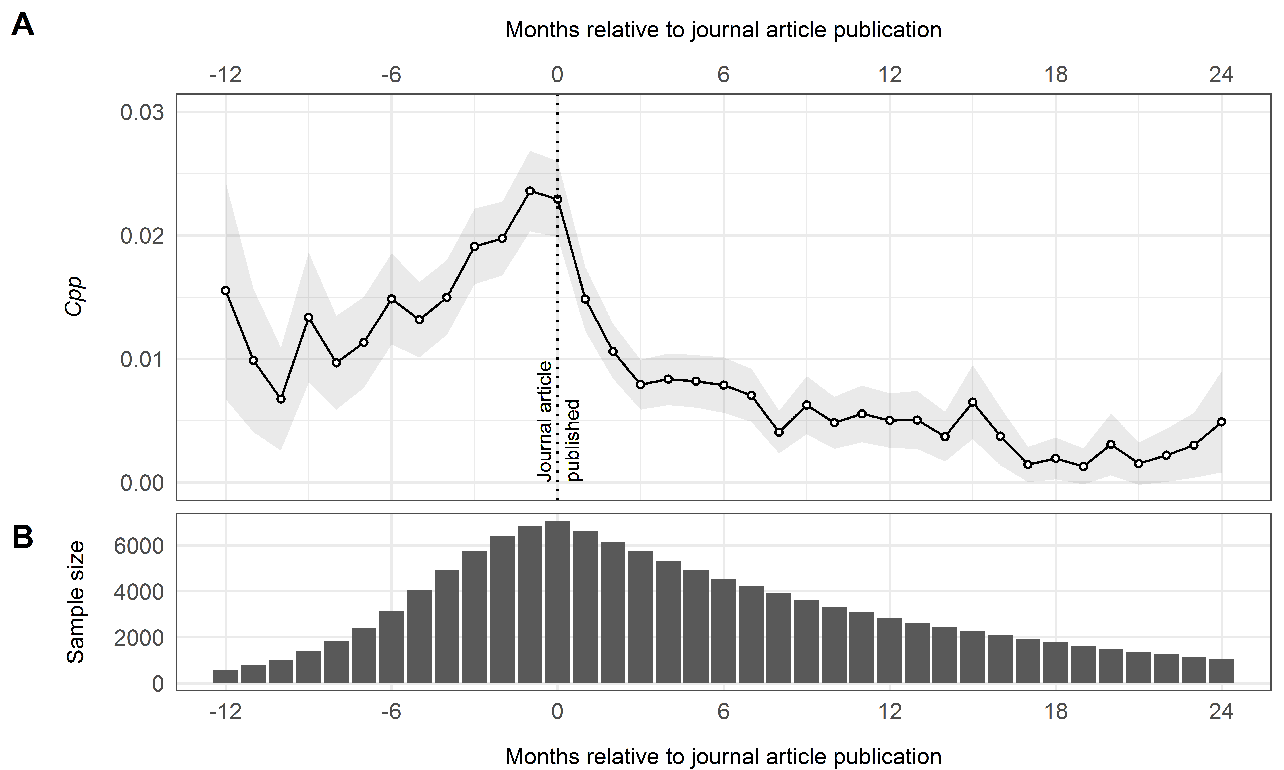
Direct citations to preprints following journal publication

Slide 37
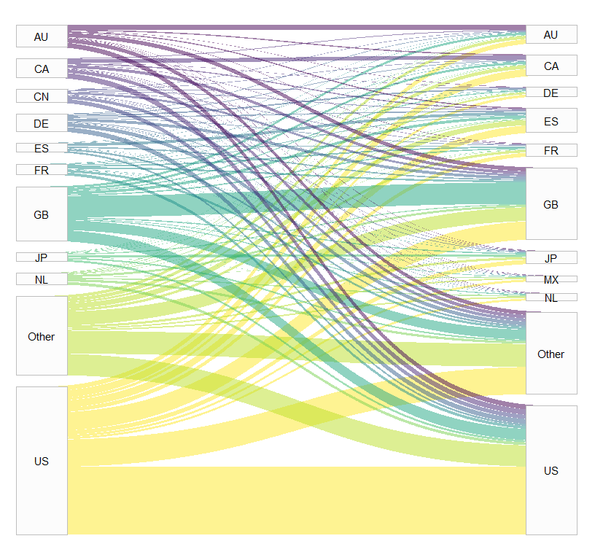
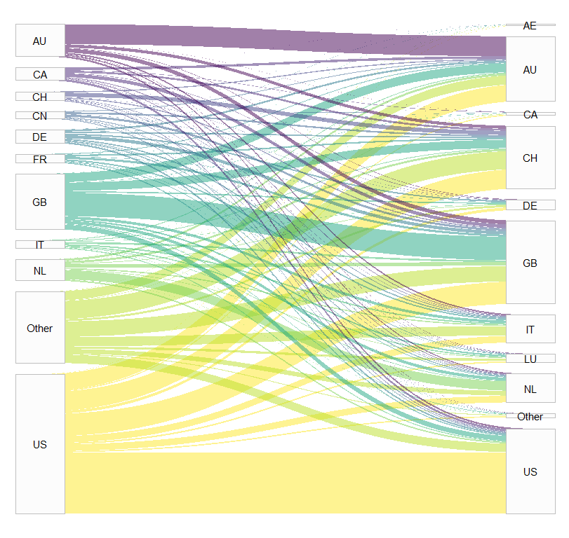
RQ4: What are the limitations in measuring the large-scale relationship between OA and altmetrics?
Countries of tweeted papers
Countries of tweeters
Countries of papers cited in policies
Source country of policies

